Slide 1
12-9-2021 Meeting

Slide 2
First sample set: 6,300 Events 18.5-19.0 log(eV) range

Slide 3
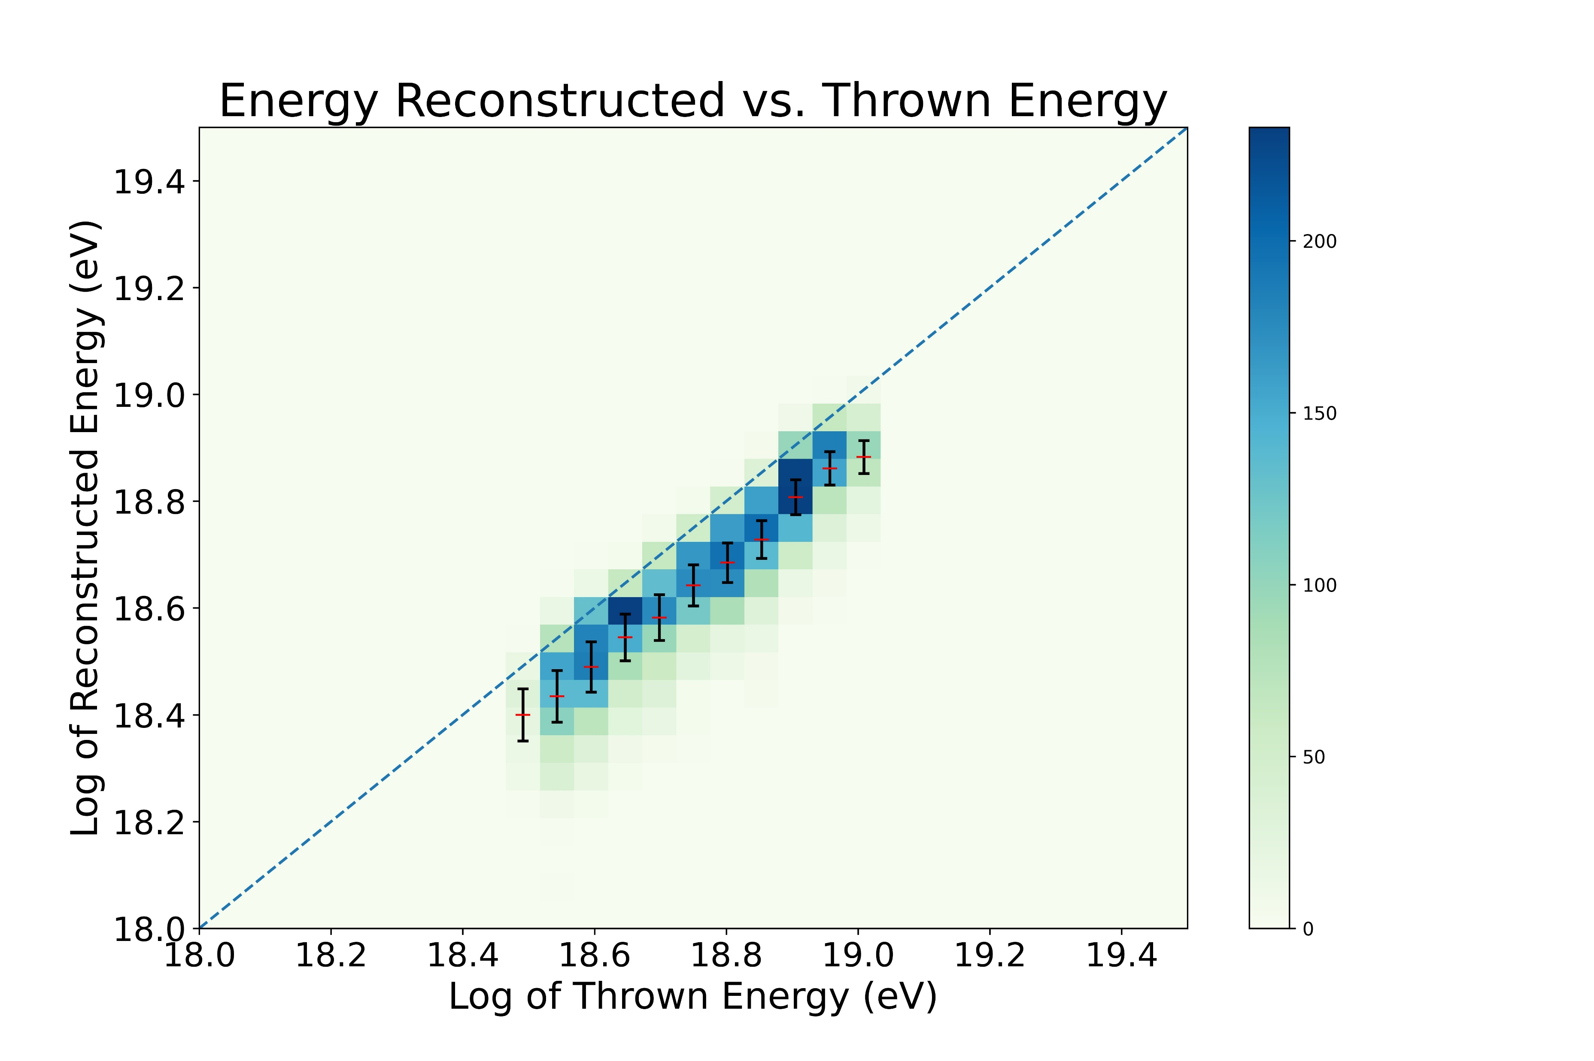

Slide 4
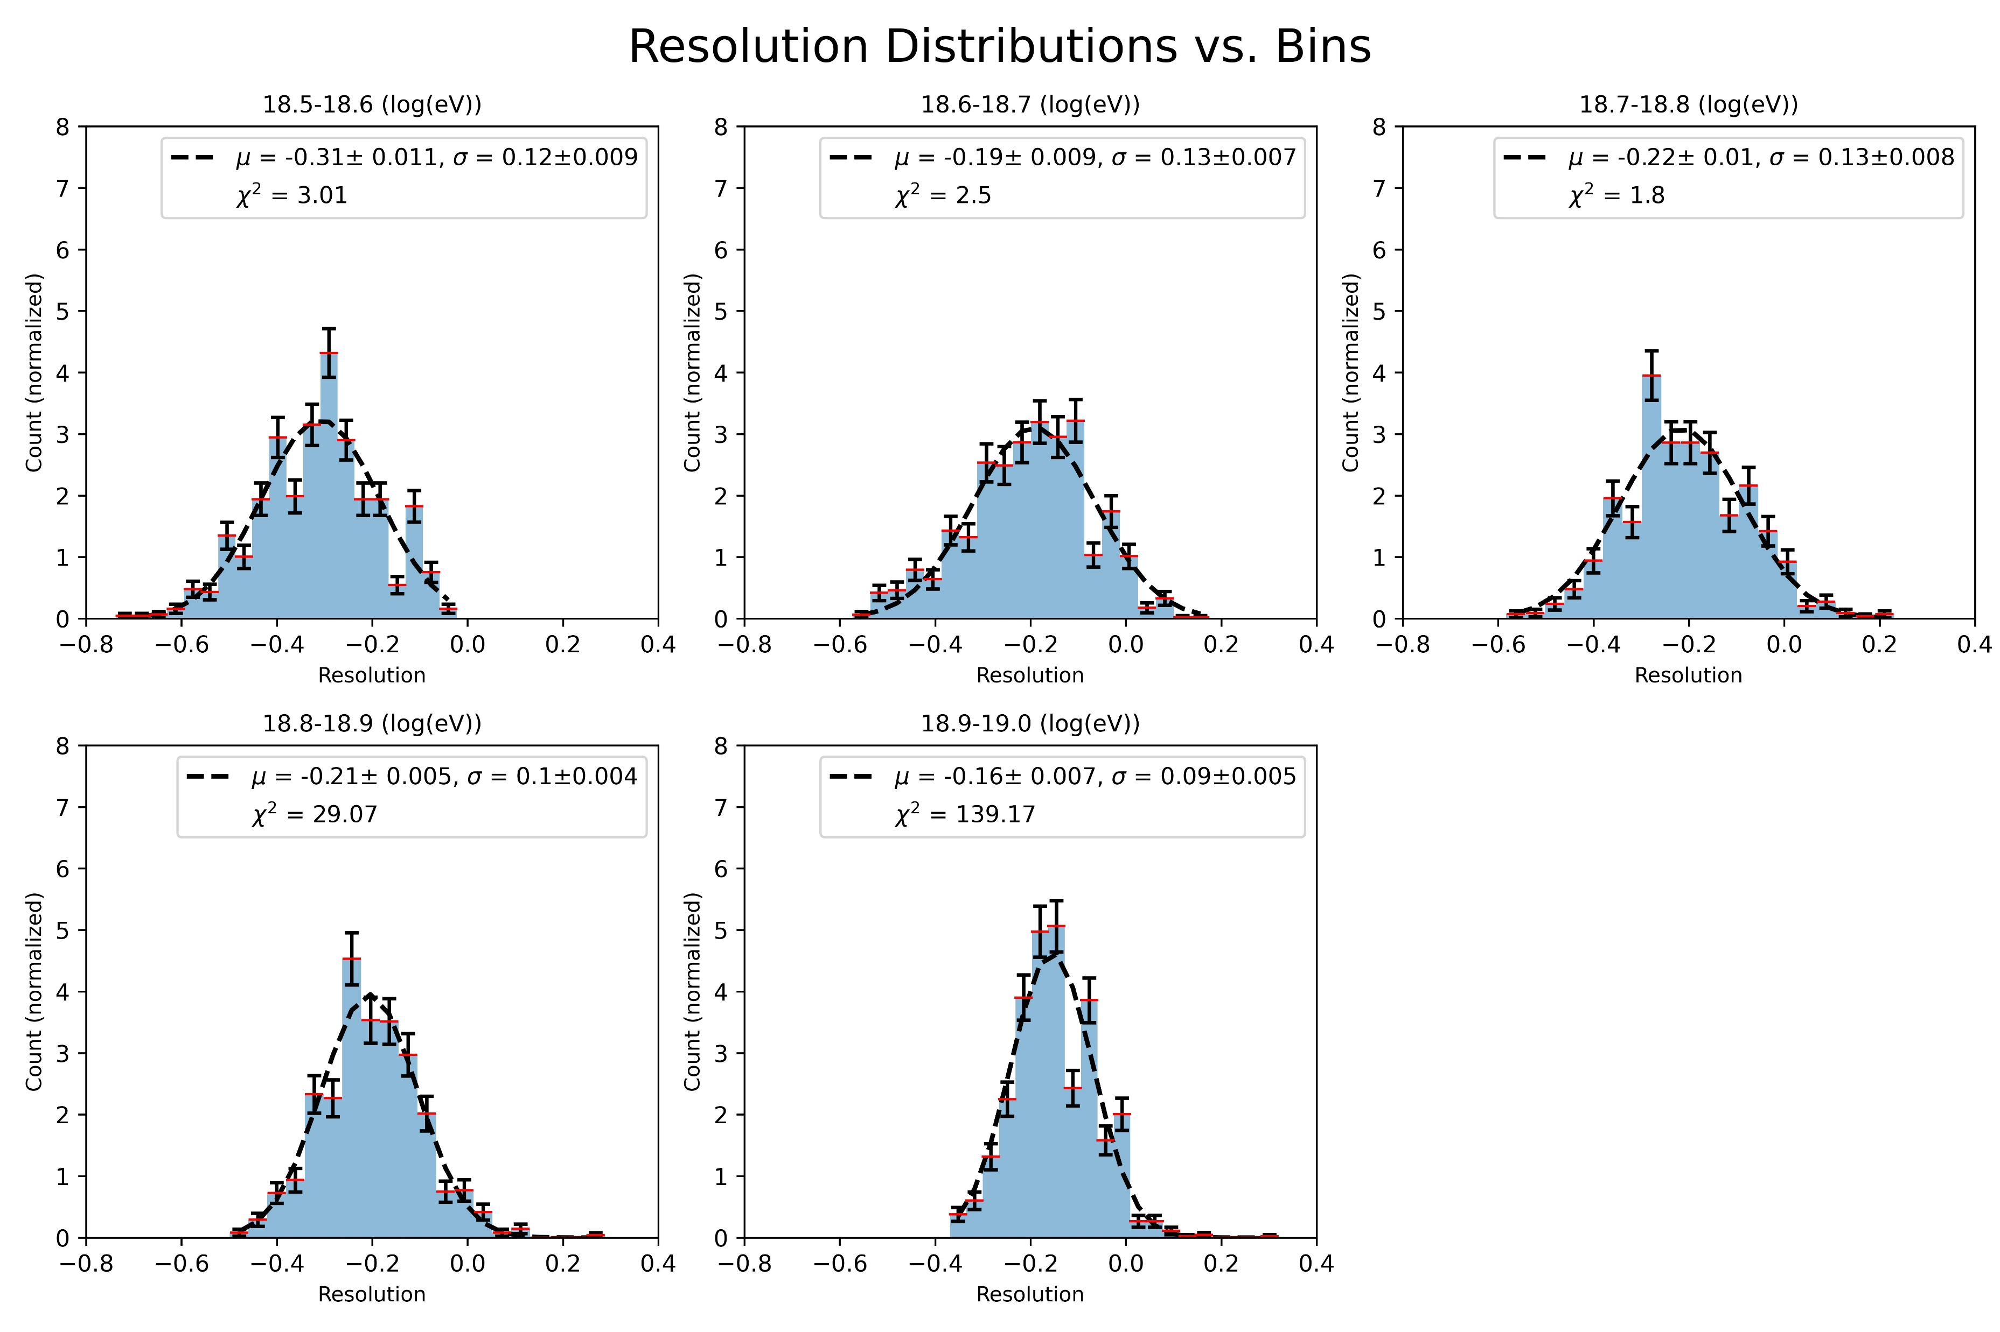

Slide 5
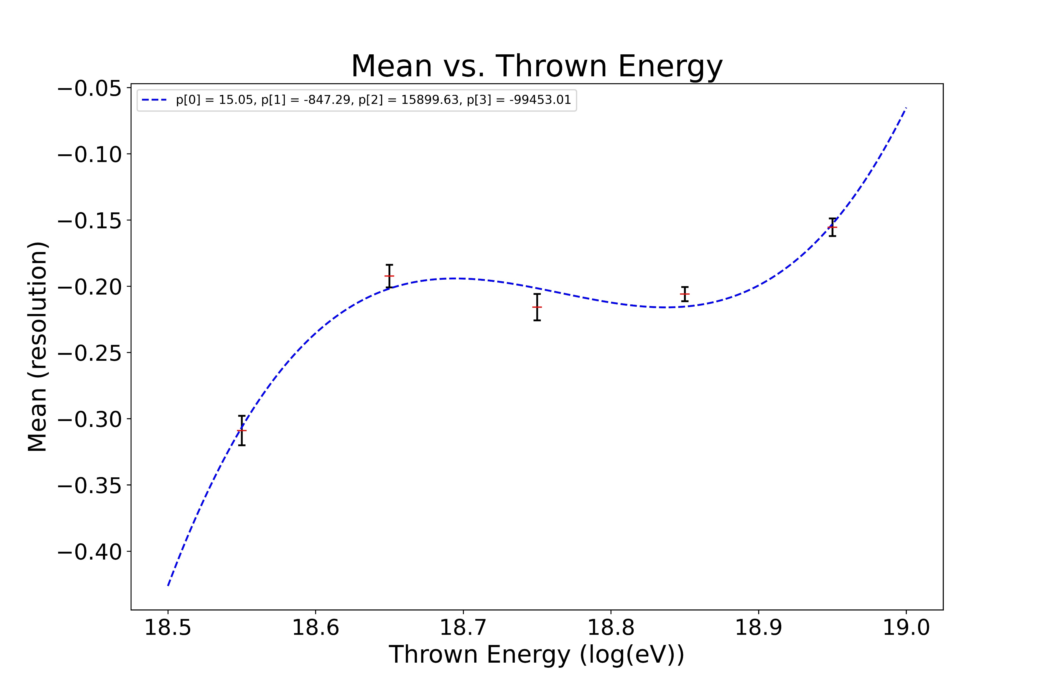

Slide 6
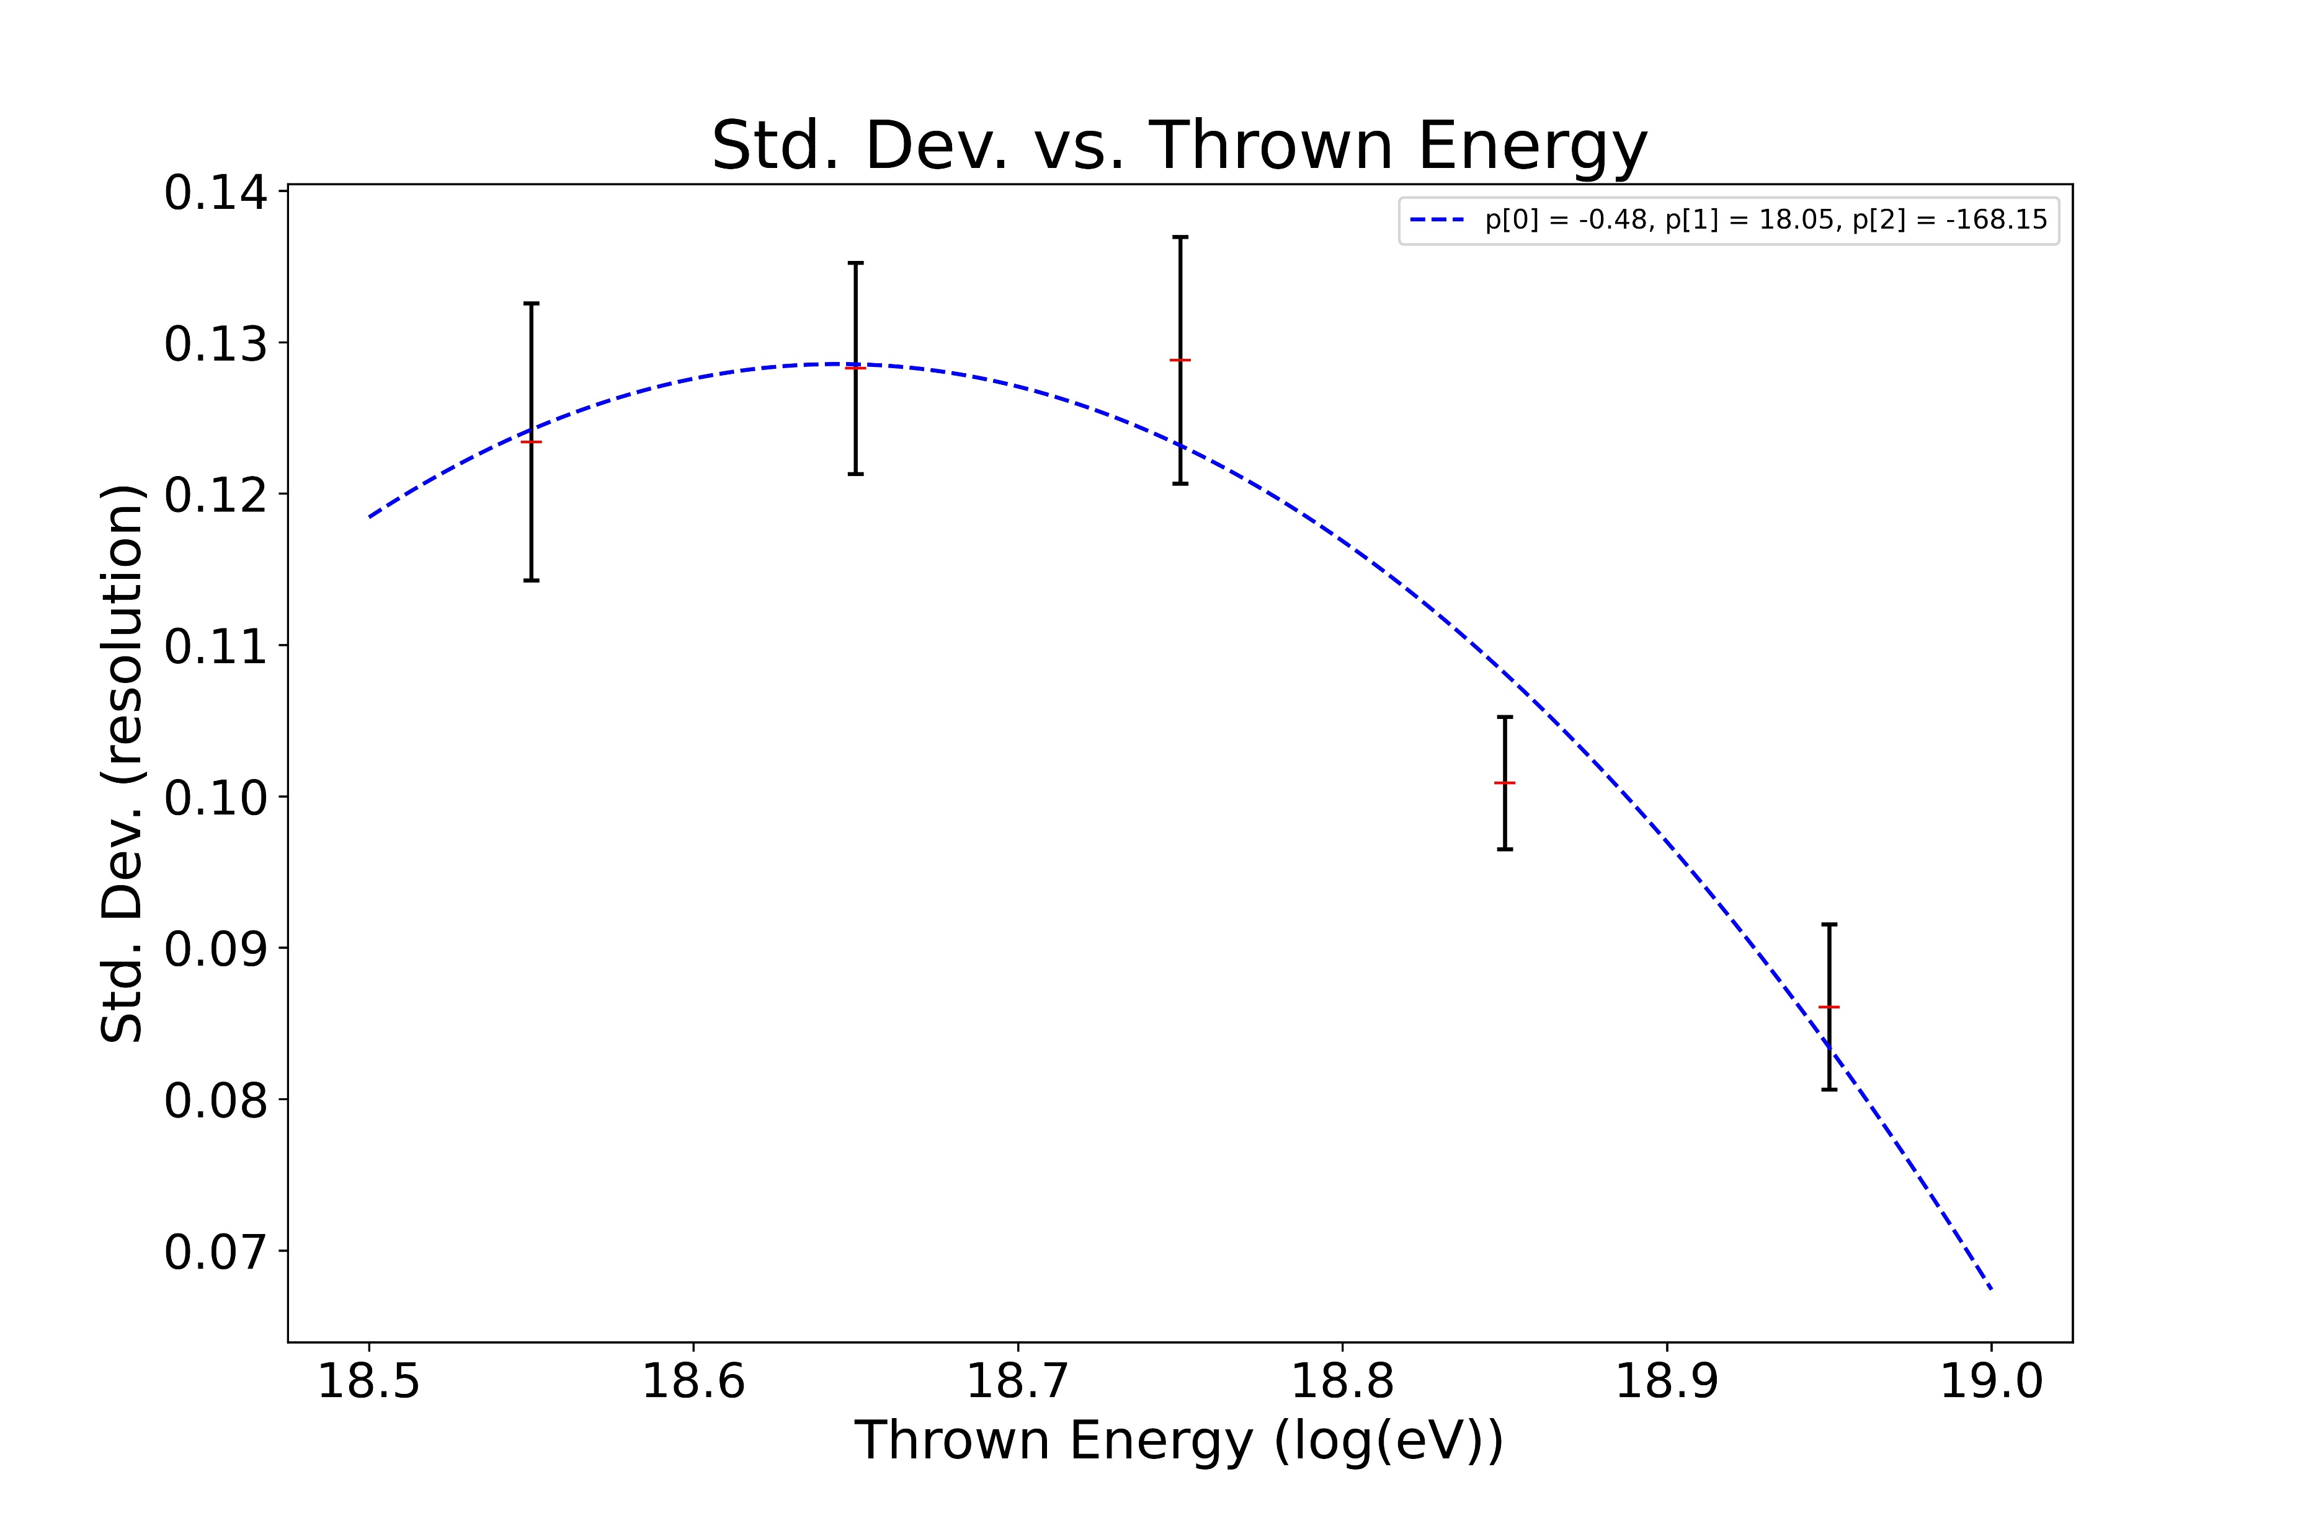

Slide 7
Second sample set: 18,300 Events 18.5-19.5 log(eV) range

Slide 8
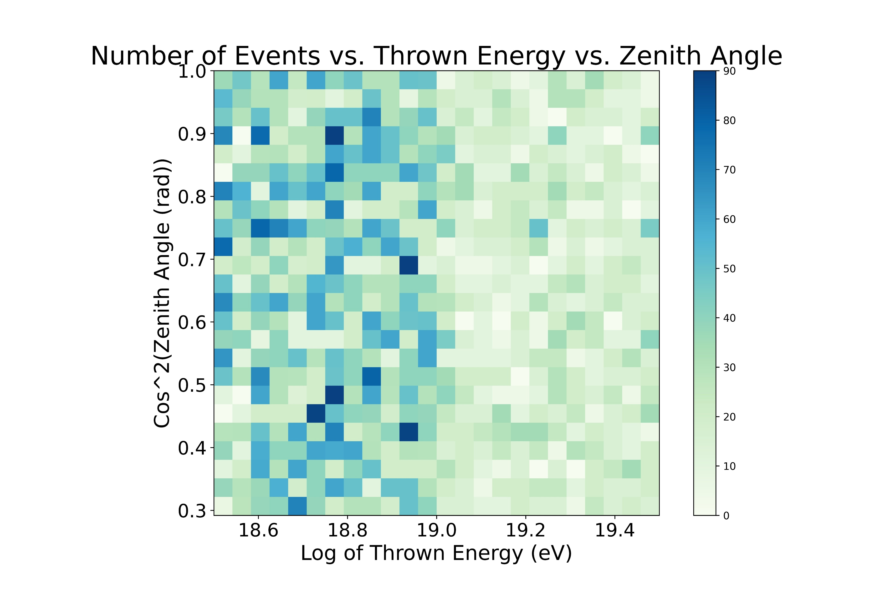

Slide 9
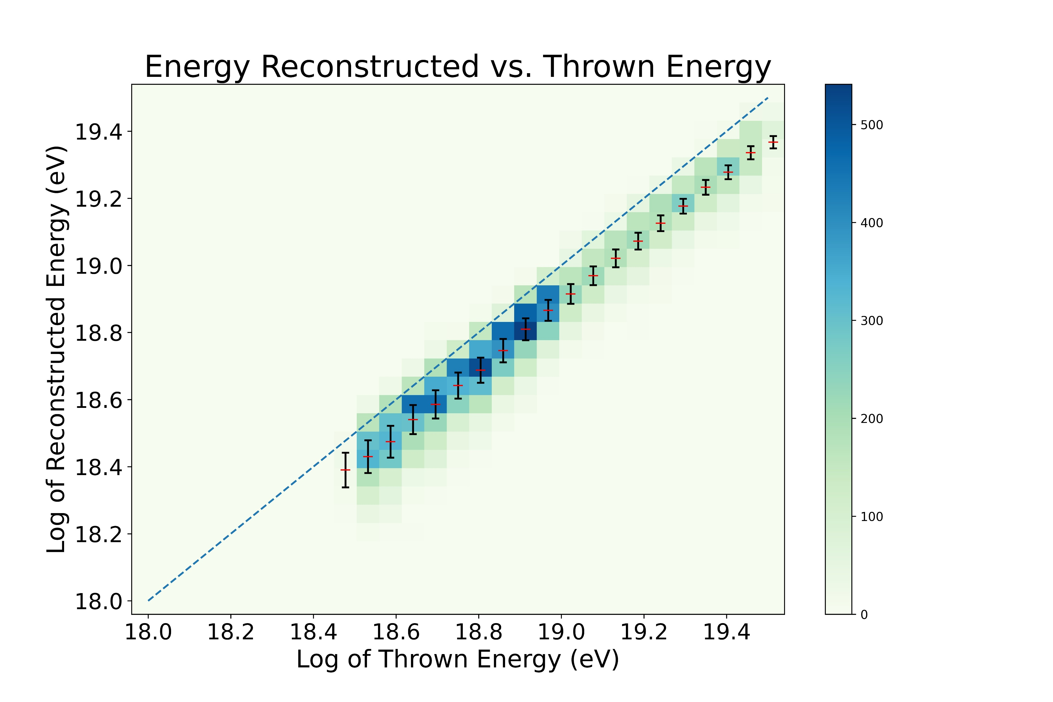

Slide 10
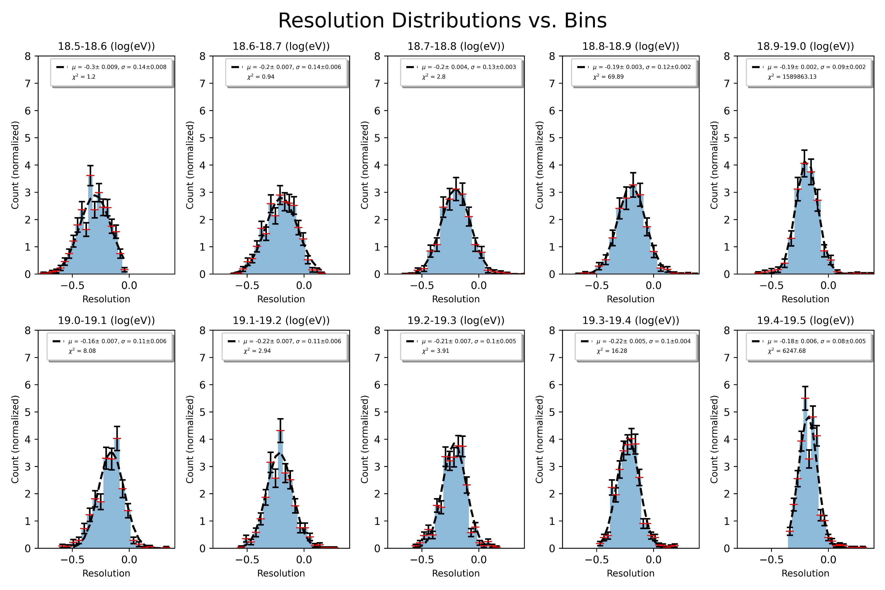

Slide 11
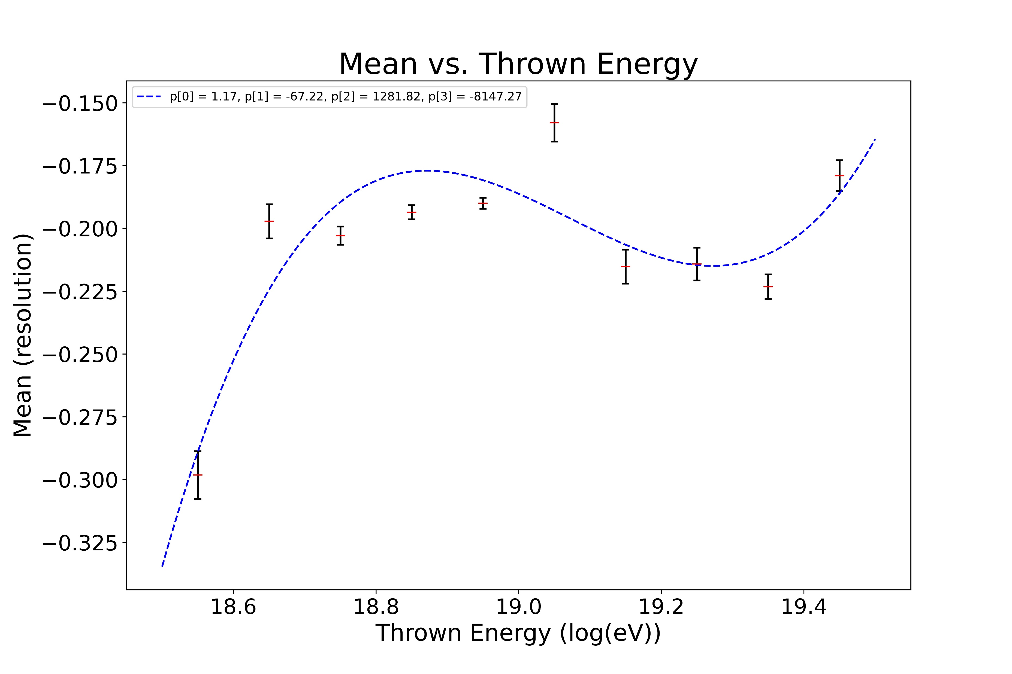

Slide 12
